Slide 1
Module 3
Data Link Layer
10.<number>
Copyright © The McGraw-Hill Companies, Inc. Permission required for reproduction or display.

Slide 2

Note
Data Link Control
&
Medium Access Control
are the 2 main functions of
Data Link Layer
10.<number>

Slide 3
Data Link Layer
Data Link Control
  Node – Node communication
  Framing
  Flow Control
  Error Control
  Software Implemented Protocols
    Smooth and Reliable Transmission of Frames bet Nodes
Medium Access Control
  Resolving access to shared media
  Nodes connected to use common link (multipoint/broadcast)
  Coordinated access to the link
  3 categories of Protocols (Random Access, Controlled Access, Channelization protocols)
2.<number>

Slide 4
Error Detection
and
Correction
10.<number>

Slide 5
Note
Data can be corrupted
during transmission.
Some applications require that
errors be detected and corrected.
Audio or Video - tolerable?
Text?
10.<number>

Slide 6
10-1 INTRODUCTION
Let us first discuss some issues related, directly or indirectly, to error detection and correction.
Topics discussed in this section:
Types of Errors
Redundancy
Detection Versus Correction
Forward Error Correction Versus Retransmission
Coding
Modular Arithmetic
10.<number>

Slide 7

10.<number>

Slide 8
When bits flow from one point to another,
Subject to interference (unpredictable changes)
- Can change the shape of signal
Note
In a single-bit error, only 1 bit in the data unit has changed.
Serial data transmission
Noise duration to corrupt a bit?
1Mbps , each bit duration?
10.<number>

Slide 9

Figure 10.1 Single-bit error
10.<number>

Slide 10
Note
A burst error means that 2 or more bits in the data unit have changed.
10.<number>

Slide 11

Figure 10.2 Burst error of length 8
First to last corrupted bit
Not consecutive!
Noise Duration = Longer than 1 bit duration
Data Rate = 1 kbps, Noise = 1/100 s -> 10 bits
1 Mbps , 10,000bits
10.<number>

Slide 12
Note
To detect or correct errors, we need to send extra (redundant) bits with data.
10.<number>

Slide 13
Detection & Correction
Error Detection
  YES/NO Answer
  Single Bit/ Burst??
Error Correction
  How many bits corrupted?
  Position of corrupted bits?
  No of Errors & Size of Message
  8 bit data Unit
    correct 1 bit error?
    Correct 2 bit errors ? – 28 possibilities
    1000 bits – 10 errors?
2.<number>

Slide 14
Forward Error Correction vs Retransmission
FEC
  Receiver guess message by using redundant bits
  Works when no of errors is small
Retransmission
  Receiver detects error occurrence
  Asks sender to retransmit message
  Resending repeated until receiver is OK!
2.<number>

Slide 15
Note
Coding Schemes – Block Coding, Convolution Coding
(Adding Redundant Bits to Actual Bits)
10.<number>

Slide 16

Figure 10.3 The structure of encoder and decoder
Relationship between actual bits and redundant bits
Receiver checks these relationship to detect/correct
10.<number>

Slide 17
Note
In modulo-N arithmetic, we use only the integers in the range 0 to N −1, inclusive.
10.<number>

Slide 18

Figure 10.4 XORing of two single bits or two words
10.<number>

Slide 19
10-2 BLOCK CODING
In block coding, we divide our message into blocks, each of k bits, called datawords. We add r redundant bits to each block to make the length n = k + r. The resulting n-bit blocks are called codewords.
Block Coding – one to one (same data word encoded always to same code word)
Topics discussed in this section:
Error Detection
Error Correction
Hamming Distance
Minimum Hamming Distance
10.<number>

Slide 20

Figure 10.5 Datawords and codewords in block coding
10.<number>

Slide 21
Example 10.1
4B/5B block coding scheme,
k = 4 and n = 5.
As we saw, we have 2^{k} = 16 datawords and 2^{n} = 32 codewords.
16 out of 32 codewords are used for message transfer and the rest are either used for other purposes or unused.
10.<number>

Slide 22

Figure 10.6 Process of error detection in block coding
Single Error Detection only
1. Receiver has list of valid code words
2. Original Code word changed to invalid one
10.<number>

Slide 23

Table 10.1 A code for error detection
10.<number>

Slide 24
Example 10.2
Let us assume that k = 2 and n = 3.
Assume the sender encodes the dataword 01 as 011 and
sends it to the receiver. Consider the following cases:
1. The receiver receives 011. It is a valid codeword. The
receiver extracts the dataword 01 from it.
10.<number>

Slide 25
Example 10.2 (continued)
2. The codeword is corrupted during transmission, and
111 is received. This is not a valid codeword and is
discarded.
3. The codeword is corrupted during transmission, and
000 is received. This is a valid codeword. The receiver
incorrectly extracts the dataword 00. Two corrupted
bits have made the error undetectable.
10.<number>

Slide 26
Note
An error-detecting code can detect
only the types of errors for which it is designed; other types of errors may remain undetected.
10.<number>

Slide 27

Figure 10.7 Structure of encoder and decoder in error correction
More redundant bits for error correction needed
10.<number>

Slide 28

Table 10.2 A code for error correction (Example 10.3)
10.<number>

Slide 29
Example 10.3
Let us add more redundant bits to see if the receiver can correct an error without knowing what was actually sent. We add 3 redundant bits to the 2-bit dataword to make 5-bit codewords. Table shows the datawords and codewords.
Assume the dataword is 01.
The sender creates the codeword 01011.
The codeword is corrupted during transmission, and 01001 is received. First, the receiver finds that the received codeword is not in the table. This means an error has occurred. The receiver, assuming that there is only 1 bit corrupted, uses the following strategy to guess the correct dataword.
10.<number>

Slide 30
Table 10.2 A code for error correction (Example 10.3)
01001
10.<number>

Slide 31
Example 10.3 (continued)
1. Comparing the received codeword with the first codeword in the table (01001 versus 00000), the receiver decides that the first codeword is not the one that was sent because there are two different bits.
2. By the same reasoning, the original codeword cannot be the third or fourth one in the table.
3. The original codeword must be the second one in the table because this is the only one that differs from the received codeword by 1 bit. The receiver replaces 01001 with 01011 and consults the table to find the dataword 01.
10.<number>

Slide 32
Error Control Concept
Note
The Hamming distance between two words is the number of differences between corresponding bits.
Apply XOR and count number of 1s
10.<number>

Slide 33

Example 10.4
Let us find the Hamming distance between two pairs of words.
1. The Hamming distance d(000, 011) is 2 because
2. The Hamming distance d(10101, 11110) is 3 because
10.<number>

Slide 34
Note
The minimum Hamming distance is the smallest Hamming distance between
all possible pairs in a set of words.
Measurement that is used
for designing a code
10.<number>

Slide 35
Table 10.1 A code for error detection
10.<number>

Slide 36
Example 10.5
Find the minimum Hamming distance of the coding scheme in Table 1
Solution
We first find all Hamming distances.
The d_{min} in this case is 2.
10.<number>

Slide 37
Table 10.2 A code for error correction (Example 10.3)
10.<number>

Slide 38
Example 10.6
Find the minimum Hamming distance of the coding scheme in Table 2
Solution
We first find all the Hamming distances.
The d_{min} in this case is 3.
10.<number>

Slide 39
Note
To guarantee the detection of up to s errors in all cases, the minimum
Hamming distance in a block
code must be dmin = s + 1.
Received codeword not to erroneously mistaken for another code word
10.<number>

Slide 40
Example 10.7
The minimum Hamming distance for our first code scheme (Table 1) is 2.
This code guarantees detection of only a single error.
For example, if the third codeword (101) is sent and one error occurs, the received codeword does not match any valid codeword.
If two errors occur, however, the received codeword may match a valid codeword and the errors are not detected.
10.<number>

Slide 41
Table 10.2 A code for error correction (Example 10.3)
10.<number>

Slide 42
Example 10.8
Our second block code scheme (Table 2) has d_{min} = 3.
This code can detect up to two errors. Again, we see that when any of the valid codewords is sent, two errors create a codeword which is not in the table of valid codewords. The receiver cannot be fooled.
However, some combinations of three errors change a valid codeword to another valid codeword. The receiver accepts the received codeword and the errors are undetected.
10.<number>

Slide 43

Figure 10.8 Geometric concept for finding d_{min} in error detection
Valid code words outside
circle
received
sent
Received code word
cannot be erroneously
mistaken for another
Code word if dist s+1
10.<number>

Slide 44

Figure 10.9 Geometric concept for finding d_{min} in error correction
Each valid code word has its own territory. Rx need to decide
Valid code word
If receiver code word belongs to territory, original code word is one at center.
Overlapping circles?
10.<number>

Slide 45
Note
To guarantee correction of up to t errors in all cases, the minimum Hamming distance in a block code
must be dmin = 2t + 1.
10.<number>

Slide 46
Example 10.9
A code scheme has a Hamming distance d_{min} = 4. What is the error detection and correction capability of this scheme?
Solution
This code guarantees the detection of up to three errors
(s = 3), but it can correct up to one error. In other words,
if this code is used for error correction, part of its capability is wasted.
Error correction codes need to have an odd minimum distance (3, 5, 7, . . . ).
10.<number>

Slide 47
10-3 LINEAR BLOCK CODES
Almost all block codes used today belong to a subset called linear block codes.
A linear block code is a code in which the exclusive OR (addition modulo-2) of two valid codewords creates another valid codeword.
Topics discussed in this section:
Minimum Distance for Linear Block Codes
Some Linear Block Codes
10.<number>

Slide 48
Note
In a linear block code, the exclusive OR (XOR) of any two valid codewords creates another valid codeword.
10.<number>

Slide 49
Table 10.1 A code for error detection
10.<number>

Slide 50
Example 10.10
Let us see if the two codes we defined in Table 10.1 and Table 10.2 belong to the class of linear block codes.
1. The scheme in Table 1 is a linear block code
because the result of XORing any codeword with any
other codeword is a valid codeword. For example, the
XORing of the second and third codewords creates the
fourth one.
2. The scheme in Table 2 is also a linear block code.
We can create all four codewords by XORing two
other codewords.
10.<number>

Slide 51
Table 10.2 A code for error correction (Example 10.3)
10.<number>

Slide 52
Example 10.11
In our first code (Table 1), the numbers of 1s in the nonzero codewords are 2, 2, and 2. So the minimum Hamming distance is dmin = 2.
In our second code (Table 2), the numbers of 1s in the nonzero codewords are 3, 3, and 4. So in this code we have d_{min} = 3.
10.<number>

Slide 53
Note
A simple parity-check code is a
single-bit error-detecting
code in which
n = k + 1 with dmin = 2.
10.<number>

Slide 54

Table 10.3 Simple parity-check code C(5, 4)
10.<number>

Slide 55

Figure 10.10 Encoder and decoder for simple parity-check code
1 bit Syndrome
10.<number>

Slide 56
Example 10.12
Let us look at some transmission scenarios. Assume the sender sends the dataword 1011. The codeword created from this dataword is 10111, which is sent to the receiver. We examine five cases:
1. No error occurs; the received codeword is 10111. The
syndrome is 0. The dataword 1011 is created.
2. One single-bit error changes a₁ . The received
codeword is 10011. The syndrome is 1. No dataword
is created.
3. One single-bit error changes r₀ . The received codeword
is 10110. The syndrome is 1. No dataword is created.
10.<number>

Slide 57
Example 10.12 (continued)
4. An error changes r₀ and a second error changes a₃ .
The received codeword is 00110. The syndrome is 0.
The dataword 0011 is created at the receiver. Note that
here the dataword is wrongly created due to the
syndrome value.
5. Three bits—a₃, a₂, and a₁—are changed by errors.
The received codeword is 01011. The syndrome is 1.
The dataword is not created. This shows that the simple
parity check, guaranteed to detect one single error, can
also find any odd number of errors.
10.<number>

Slide 58
Note
A simple parity-check code can detect an odd number of errors.
10.<number>

Slide 59
Note
All Hamming codes focused here have dmin = 3.
The relationship between m and n in these codes is n = 2^{m} − 1.
Number of check bits r = m
Choose an integer m>=3, k = n-m
10.<number>

Slide 60

Table 10.4 Hamming code C(7, 4)
10.<number>

Slide 61

Figure 10.12 The structure of the encoder and decoder for a Hamming code
10.<number>

Slide 62

3 bit syndrome – eight patterns
Lack of error/ error in 1 of 7 bits
q0 is in error – s0 is affected
b2 in error – s0 & s1 affected
Table 10.5 Logical decision made by the correction logic analyzer
10.<number>

Slide 63
Example 10.13
Let us trace the path of three datawords from the sender to the destination:
1. The dataword 0100 becomes the codeword 0100011.
The codeword 0100011 is received. The syndrome is
000, the final dataword is 0100.
2. The dataword 0111 becomes the codeword 0111001.
Codeword 0011001 is received/ The syndrome is 011.
  After flipping b₂ (changing the 1to 0), the final dataword is 0111.
3. The dataword 1101 becomes the codeword 1101000.
00010000 is received. The syndrome is 101.
After flipping b₀, we get 0000, the wrong dataword. This shows that our code cannot correct two errors.
10.<number>

Slide 64
Example 10.14
We need a dataword of at least 7 bits. Calculate values of k and n that satisfy this requirement.
Solution
We need to make k = n − m greater than or equal to 7, or 2^{m} − 1 − m ≥ 7.
1. If we set m = 3, the result is n = 2³ − 1 and k = 7 − 3,
or 4, which is not acceptable.
2. If we set m = 4, then n = 2⁴ − 1 = 15 and k = 15 − 4 =
11, which satisfies the condition. So the code is
C(15, 11)
10.<number>

Slide 65

Figure 10.11 Two-dimensional parity-check code
Dataword organized in table. 7-bit bytes put in separate rows.
Each row/column – 1 parity check bit. Send whole table
To Rx. Syndrome calculated for each row/column
2D parity check – can detect upto 3 errors .
10.<number>

Slide 66

Figure 10.11 Two-dimensional parity-check code
Worst cases
Guarantee correction upto 1 error
10.<number>

Slide 67

Figure 10.11 Two-dimensional parity-check code
Guarantee?
10.<number>

Slide 68

Split Burst error between several codewords, 1 error for each
Figure 10.13 Burst error correction using Hamming code
Only 1 bit in each code
Is corrupted
Hamming code to respond to burst error
Of size N, make N codewords of frame
Arrange codewords
Send column by column
10.<number>
Instead of sending one codeword at a time…

Slide 69
10-4 CYCLIC CODES
Cyclic codes are special linear block codes with one extra property. In a cyclic code, if a codeword is cyclically shifted (rotated), the result is another codeword.
Topics discussed in this section:
Cyclic Redundancy Check
Polynomials
10.<number>

Slide 70

Table 10.6 A CRC code with C(7, 4)
10.<number>

Slide 71
Dataword – k bits
Codeword – n bits
Size of dataword is augmented
by adding (n-k) 0’s to right
n-bit result fed to generator
Generator uses divisor
(n-k+1) size predefined and agreed upon
Append reminder to dataword
10.<number>

Slide 72

Figure 10.14 CRC encoder and decoder
10.<number>

Slide 73
Table 10.6 A CRC code with C(7, 4)
10.<number>

Slide 74
Dataword – 1001
Agreed upon Divisor = 1011
10.<number>

Slide 75

Figure 10.15 Division in CRC encoder
10.<number>

Slide 76
Received Codeword – 1000
Agreed upon Divisor = 1101
10.<number>

Slide 77

Figure 10.16 Division in the CRC decoder for two cases
10.<number>

Slide 78

Figure 10.21 A polynomial to represent a binary word
Power of each term – position of bit
Coefficient – value of bit
Degree of polynomial = 1 less than no of bits
10.<number>

Slide 79
Dataword – 1001
Agreed upon Divisor = 1011
Shifting the polynomial to left
- multiplying each term by x^{m}
10.<number>

Slide 80

Figure 10.22 CRC division using polynomials
10.<number>

Slide 81
Note
The divisor in a cyclic code is normally called the generator polynomial
or simply the generator.
10.<number>

Slide 82
Dataword – d(x)
Codeword – c(x)
Generator – g(x)
Syndrome – s(x)
Error – e(x)
10.<number>

Slide 83
Note
In a cyclic code,
If s(x) ≠ 0, one or more bits is corrupted.
If s(x) = 0, either
a. No bit is corrupted. or
b. Some bits are corrupted, but the
decoder failed to detect them.
10.<number>

Slide 84
Note
In a cyclic code, those e(x) errors that are divisible by g(x) are not caught.
Received code word = sum of code word and
Error
e(x) is 0 or e(x) is divisible by g(x)
10.<number>

Slide 85
How to catch Single-bit Error?
g(x) to detect?
10.<number>

Slide 86
How to catch Single-bit Error?
g(x) to detect?
e(x) = x^{i} (i = position)
x^{i should not be divisible} by g(x)
10.<number>

Slide 87
Note
If the generator has more than one term and the coefficient of x⁰ is 1,
all single errors can be caught.
10.<number>

Slide 88
Example 10.15
Which of the following g(x) values guarantees that a single-bit error is caught? For each case, what is the error that cannot be caught?
a. x + 1 b. x³ c. 1

Slide 89
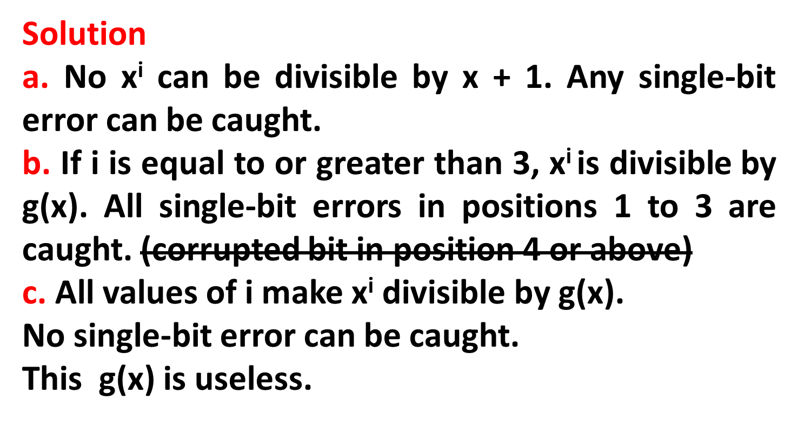
Example 10.15
Which of the following g(x) values guarantees that a single-bit error is caught? For each case, what is the error that cannot be caught?
a. x + 1 b. x³ c. 1

Slide 90

Figure 10.23 Representation of two isolated single-bit errors using polynomials
Distance bet errors
10.<number>

Slide 91
Figure 10.23 Representation of two isolated single-bit errors using polynomials
Distance bet errors
e(x) = x^{j}+x^{i} = x^{i}(x^{j-i}+1)
10.<number>

Slide 92
Note
If a generator cannot divide x^{t} + 1
(t between 0 and n – 1),
then all isolated double errors
can be detected.
10.<number>

Slide 93
Example 10.16
Find the status of the following generators related to two isolated, single-bit errors.
a. x + 1
b. x⁴ + 1
c. x⁷ + x⁶ + 1
d. x¹⁵ + x¹⁴ + 1
10.<number>

Slide 94
Example 10.16
Find the status of the following generators related to two isolated, single-bit errors.
a. x + 1 b. x⁴ + 1 c. x⁷ + x⁶ + 1 d. x¹⁵ + x¹⁴ + 1
Solution
a. This is a very poor choice for a generator. Any two
errors next to each other cannot be detected.
b. This generator cannot detect two errors that are four
positions apart.
c. This is a good choice for this purpose.
d. This polynomial cannot divide x^{t} + 1 if t is less than
32,768. A codeword with two isolated errors up to
32,768 bits apart can be detected by this generator.
10.<number>

Slide 95
Note
A generator that contains a factor of
x + 1 can detect all odd-numbered errors.
x⁴ + x²+ x + 1 = (x+1)(x³+ x²+ 1)
10.<number>

Slide 96
Burst Error
How to represent?
10.<number>

Slide 97
Burst Error
e(x) = x^{j}+………+ x^{i} = x^{i}(x^{j-i}+…..+1)
Worry about the generators that divide
(x^{j-i}+…..+1)
Remainder of x^{j-i}+…..+1 / x^{r}+…..+1 must
Not be zero.
10.<number>

Slide 98
3 cases
If j-i < r
If j-i = r
If j-i > r
Length of Burst (L) can be < r , = r , r+1, > r
10.<number>

Slide 99
❏ if j-i < r , the remainder can never be 0
Let’s write j-i = L-1
L – Length of error
L-1 < r
L < r + 1
Or
L < r
All Burst Errors with length < number of check bits r will be detected.
10.<number>

Slide 100
❏ if j-i =r, or
L = r+1
Syndrome is 0 and undetected
Probability of undetected burst error
of length r+1 is (1/2)^{r-1}
Ex : x¹⁴+x³+1 , r=14
A burst error of length 15 can slip undetected
with probability of (1/2)¹⁴⁻¹ or 1 in 10,000
10.<number>

Slide 101
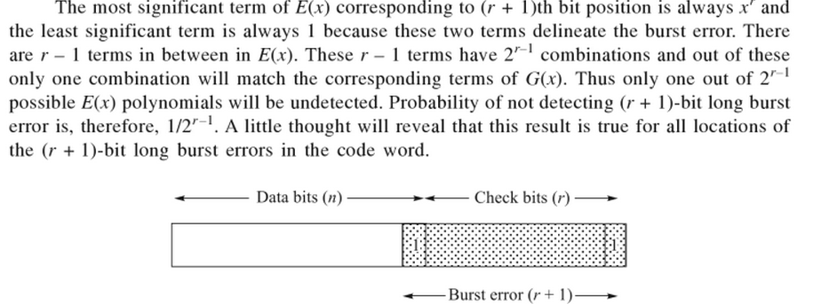
Burst Error of Length r+1
Error Polynomial will be of degree r
G(x) will completely divide e(x) only if e(x) match G(x) term by term
10.<number>

Slide 102
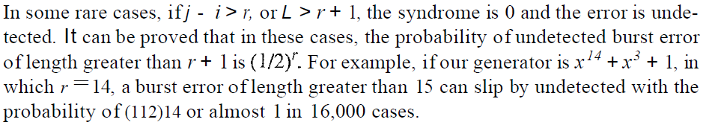
Burst Error of Length > r+1
10.<number>

Slide 103
Note
❏ All burst errors with L ≤ r will be
detected.
❏ All burst errors with L = r + 1 will be
detected with probability 1 – (1/2)^{r–1}.
❏ All burst errors with L > r + 1 will be
detected with probability 1 – (1/2)^{r}.
10.<number>

Slide 104
Example 10.17
Find the suitability of the following generators in relation to burst errors of different lengths.
x⁶ + 1
x¹⁸ + x⁷ + x + 1
x³² + x²³ + x⁷ + 1
10.<number>

Slide 105
Example 10.17
Find the suitability of the following generators in relation to burst errors of different lengths.
a. x⁶ + 1 b. x¹⁸ + x⁷ + x + 1 c. x³² + x²³ + x⁷ + 1
Solution
a. This generator can detect all burst errors with a length
less than or equal to 6 bits; 3 out of 100 burst errors
with length 7 will slip by; 16 out of 1000 burst errors of
length 8 or more will slip by.
10.<number>

Slide 106
Example 10.17 (continued)
b. This generator can detect all burst errors with a length
less than or equal to 18 bits; 8 out of 1 million burst
errors with length 19 will slip by; 4 out of 1 million
burst errors of length 20 or more will slip by.
c. This generator can detect all burst errors with a length
less than or equal to 32 bits; 5 out of 10 billion burst
errors with length 33 will slip by; 3 out of 10 billion
burst errors of length 34 or more will slip by.
10.<number>

Slide 107
Note
A good polynomial generator needs to have the following characteristics:
1. It should have at least two terms.
2. The coefficient of the term x⁰ should
be 1.
3. It should not divide x^{t} + 1, for t
between 2 and n − 1.
4. It should have the factor x + 1.
10.<number>

Slide 108
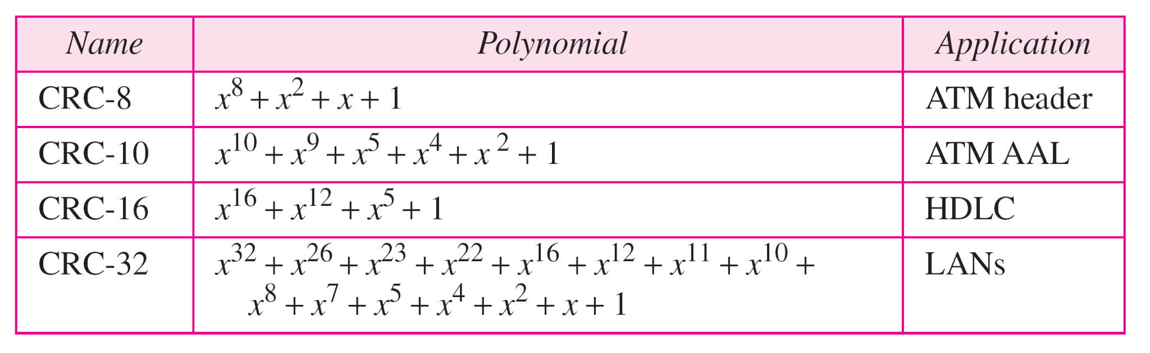
Table 10.7 Standard polynomials
10.<number>

Slide 109
11-1 FRAMING
The data link layer needs to pack bits into frames, so that each frame is distinguishable from another. Our postal system practices a type of framing. The simple act of inserting a letter into an envelope separates one piece of information from another; the envelope serves as the delimiter.
Larger Frames
Inefficient Error & Flow Control
Single Bit Error – would require retransmission of entire message if packed in very large frame.
11.<number>

Slide 110
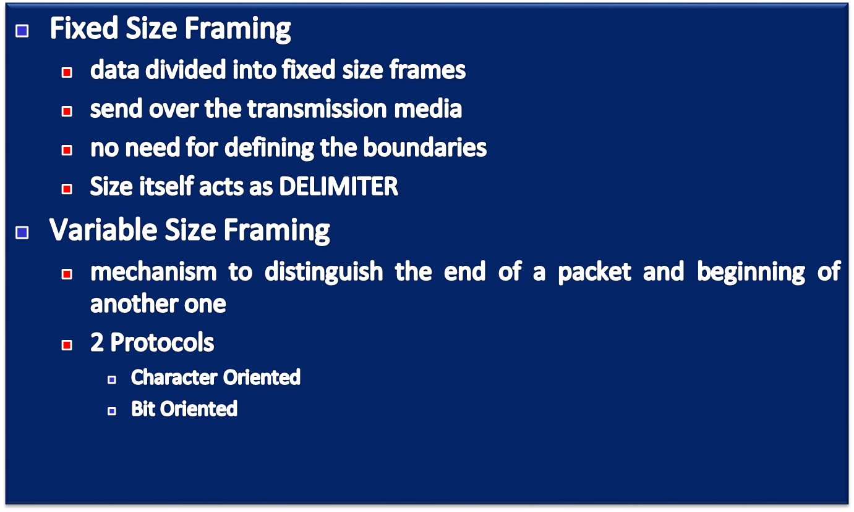
Fixed vs Variable Size Framing

Slide 111

Figure 11.1 A frame in a character-oriented protocol
1 byte flag – spl character
Signals start and end of frame
Other than text, audio, video etc..
Flag part of data?
11.<number>

Slide 112

Figure 11.2 Byte stuffing and unstuffing
Unicode – 32 bit
11.<number>

Slide 113
Note
Byte stuffing is the process of adding 1 extra byte whenever there is a flag or escape character in the text.
11.<number>

Slide 114

Figure 11.3 A frame in a bit-oriented protocol
Universal coding system such as Unicode – 32 bit characters
11.<number>

Slide 115
Note
Bit stuffing is the process of adding one extra 0 whenever five consecutive 1s follow a 0 in the data, so that the receiver does not mistake
the pattern 0111110 for a flag.
11.<number>

Slide 116

Figure 11.4 Bit stuffing and unstuffing
11.<number>

